Slide 1
Ethics Training Elected Officials, Council Staff, DIA and JAA Presented by
Kirby Oberdorfer, Executive Director Andrea Myers, Program & Training Manager Office of Ethics, Compliance and Oversight
City of Jacksonville, Florida
Notes:
Good MORNING everyone!
I am Kirby Oberdorfer, I serve as Director of Ethics Office. Very fortunate to work with such a talented and dedicated group in Ethics Office Andrea Myers, our Training Manager, who has expertise in adult learning and is on this call today.

Slide 2
Agenda: Annual State Ethics Training FINAL HOUR!!
Welcome and Introductions
What’s New with Ethics
What’s Newsworthy in Ethics
Wrap-Up/Questions & Answers
Notes:
Cheryl Brown??

Slide 3
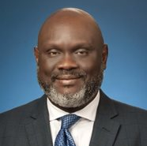
Introductory Remarks
Council President Samuel Newby

Slide 4
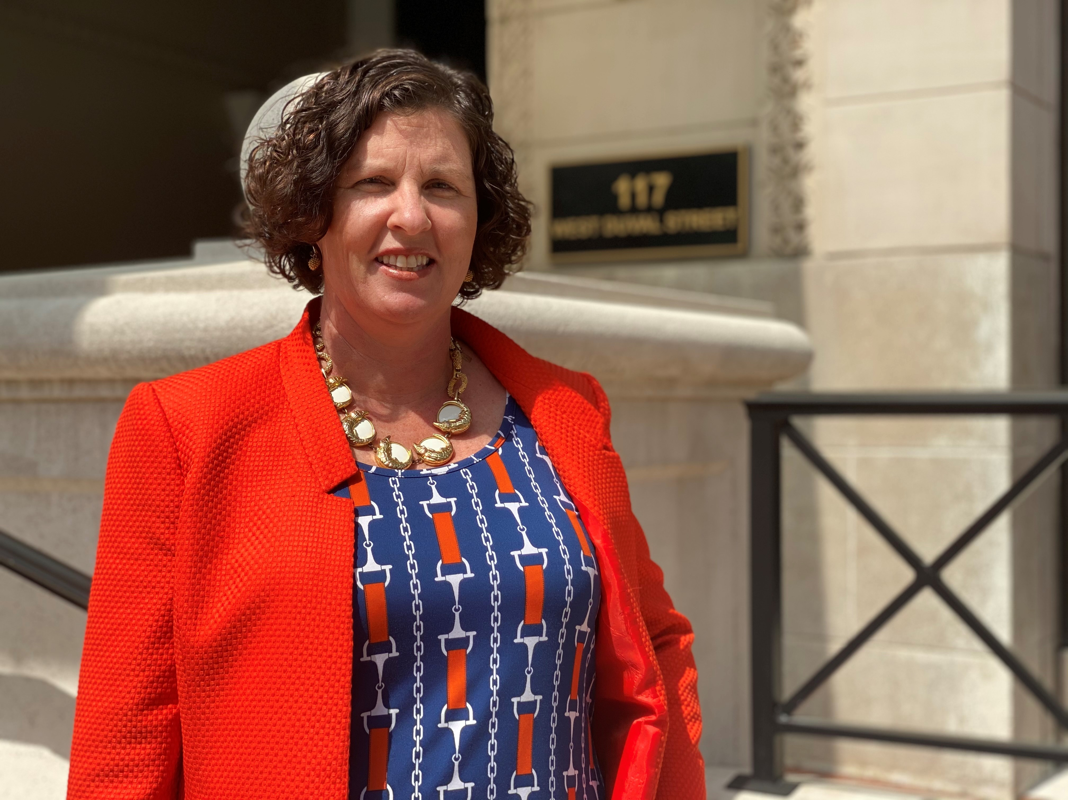
Ethics Welcome
Kirby Oberdorfer, Ethics Director
City of Jacksonville
(904) 255-5510
koberdorfer@coj.net
Helpline
(904) 630-1015
Notes:
Thank them for their support of you coming on as Director! It has been a wild couple of months but you’re appreciative of them and their efforts to do things as ethically and transparently as possible
The tone at the top matters!! Give a tiny snippet of the data – in addition to helping make sure all 6000+ employees here at COJ know the law, and helping those that come to us with questions, we also belong to a professional field that does a lot of research on human behavior focusing on what really makes a difference when it comes to ethics… and all the data shows that what really matters when it comes to ethics is, the tone at the top! That’s you all, so it really matters when you all make an effort to do things in a transparent fashion and when you model taking appropriate gifts… thank you for always being so conscientious and for being such good sports in our annual trainings even though they are required by law☺
Here’s our agenda for the training today:
What’s New, What’s Hot, and What’s Newsworthy

Slide 5
Opening Activity

Slide 6
Electronic Voting System
Smartphone or tablet
Go to Slido.com
Enter Code #441921

Slide 7
SLIDO-- WARMUP
What is on your Thanksgiving Menu?
Select all that apply:
1. Turkey 6. Vegetable Casserole
2. Ham 7. Pies
3. Dressing
4. Mashed Potatoes
5. Sweet Potatoes
Notes:
Test out the SLIDO
Find out how many of us will be eating Turkey this Thanksgiving!

Slide 8
SLIDO - How Do You Feel?
Builds your Trust in Government
Diminishes your Trust in Government
I am not sure
Notes:
For our warmup, we’re sharing an activity we do with all new employees of the City….
I would like for you to put on your hat as a taxpayer to consider how you feel about the government employee’s behavior—is it ok or do you have concerns about it?
How do you feel as a taxpayer if you read in the paper:
OK, no problems
I am not sure or have no opinion
Seems unfair or wrong
Number#1
A City employee uses City resources to create extra copies of a permit for citizens, charges them $5 and keeps the money for themselves… over the course of the year, the pocketed money totals 10% his salary? In the chat, 1, 2, or 3…..
Next,
How would you feel if a department head orders City employees, on City time, with City equipment, to clean debris from her yard following a hurricane that left damage across the region. In the chat, 1, 2, or 3.
Does it surprise you to know that these are both real life examples from the State of Florida?

Slide 9
Notes:
As Daughter Sought State License, Noem Summoned Agency Head | Political News | US News

Slide 10
WHAT’S NEW IN ETHICS?

Slide 11
GIFTS

Slide 12
SLIDO – What’s Your Best Guess?
Gift Laws Were First Enacted:
Founding of United States
19th Century
Early 2oth Century
Post-Watergate Era
1980’s
Early 21st Century

Slide 13
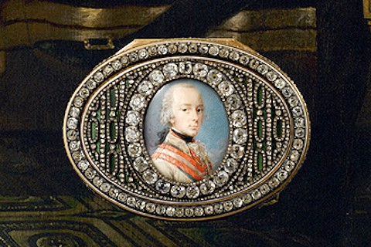
ORIGINAL GIFT LAW
Notes:
The first ethics laws for public officials were created around the time of the Revolutionary War…. Benjamin Franklin was the Ambassador to France and his special relationship with the King of France meant securing sufficient money and supplies for the Revolution so the colonies were able to defeat the British crown… so when it was time for Franklin to come back home to the United States, the King of France gave him a gift… the snuff box you see here which was full of diamonds.
Franklin’s colleagues in Congress thought it was simply outrageous that he was able to amass so much wealth just for doing his job and it may compromise his dealings with France… it wasn’t fair, they didn’t like it
Before we continue with the story and see how it turned out, imagine you were a public official in Congress during the Revolutionary War. Answer this poll . . . Is it ethical for Benjamin Franklin to accept box? Should Benjamin Franklin accept box? Why/Why not?
Answer: Congress wanted him to return the snuff box to the King of France and Franklin wouldn’t agree because it would be rude—a slap in the face, if you will. So they reached a compromise that Franklin could keep it in his family, but none of the diamonds could be removed and taken for personal use. This worked well until his daughter inherited it and removed the diamonds to finance her personal trips abroad and other things. So you can see that some of the diamonds are missing. Snuff box now in museum in Philadelphia.

Slide 14
SLIDO
You receive Jaguars tickets from the Council President’s Office. Is this a gift?
YES
NO
UNCLEAR
Notes:
Yes
No
Unclear

Slide 15
SLIDO
The Council President gives you two Jaguars tickets that are part of the City’s contract with the Jaguars. The face value of each ticket is $130. Can you accept the tickets?
YES
NO
UNCLEAR
Notes:
Yes
No
Unclear

Slide 16
SLIDO
Should you report the two Jaguars tickets ($260 total value) from the Council President on a Form 9 quarterly gift disclosure?
YES
NO
UNCLEAR
Notes:
Yes
No
Unclear
Yes – AND THEY ARE FROM ‘THE CITY’ AND THE VALUE IS THE FACE VALUE ON THE TICKETS

Slide 17
SLIDO
The Council President gives you two Jaguars tickets for a playoff game that are NOT part of the City’s contract with the Jaguars. The face value of each ticket is $130. Can you accept the tickets?
YES
NO
UNCLEAR
Notes:
Yes
No
Unclear
INDIRECT GIFT FROM A THIRD PARTY: If a third party gives a gift to the Council President, Mayor’s Office or your ECA and the gift is intended to be given to you, it is an indirect gift to you from the third party.

Slide 18
SLIDO
Can a vendor or lobbyist of the City give you a gift with a value exceeding $100 if they give it to the City through the Council President’s Office or the Mayor’s Office?
YES
NO
UNCLEAR

Slide 19
Gifts Paid
by City
City Contract
or Sponsorship
Accept any Amount
Determine Value
Report on Form 9 > $100
Gifts Paid
by Others
Who Paid?
What Value?
Why?
Not Vendor or Lobbyist:
Accept any Amount
Determine Value
Report on Form 9 > $100
If Vendor or Lobbyist:
Determine Value
Decline or Pay Down if > $100
Notes:
If tickets are part of a City contract, they are from the City. All other tickets given to the Council President or Mayor’s office for your use are indirect gifts to you. Find out who gave/provided the tickets before you decide what to do. If you’re not sure, ask the Ethics Office.
CEO 19-17—October 30, 2019
For purposes of Section 112.3148, Florida Statutes, a city official or employee who files financial disclosure (a reporting individual) has received a “gift” from the city when they accept complimentary tickets to events sponsored in part by the city and hosted by for-profit or non-profit entities. As the gift involves a ticket(s), its valuation is controlled by Section 112.3148(7), Florida Statutes, and Rule 34-13.500, Florida Administrative Code. As there is no indication that the tickets are an indirect gift from a lobbyist or from a partner, firm, employer, or principal of a lobbyist who lobbies the city or a vendor of the city for purposes of Section 112.3148(4), Florida Statutes, the city officials and city employees may accept the ticket(s), but where the combined face value of the tickets accepted by a reporting individual exceeds $100, the reporting individual must disclose them pursuant to Section 112.3148(8), Florida Statutes. Further, tickets or admissions to VIP events or to early performances not otherwise available to the public and given to public officers and employees who file financial disclosure would be considered gifts. Also, where a reporting individual receives complimentary tickets to fundraising events held by non-profit entities that receive funding from the city, the ticket(s) would constitute an indirect gift from the non-profit, which could be accepted provided that the non-profit is not a lobbyist or the partner, firm, employer, or principal of a lobbyist who lobbies the city or a vendor of the city, but the tickets must be disclosed quarterly on a CE Form 9. Further, pursuant to Section 112.3148(7)(h), Florida Statutes, and Rule 34-13.500(5)(d), Florida Administrative Code, the value of a ticket to a charitable fundraising event is the face value of the ticket or if no face value was provided the published cost of admission to persons with similar tickets. Referenced are CEO 91-57, CEO 92-33, CEO 93-27, CEO 94-43, CEO 95-36, CEO 96-2, CEO 04-12, CEO 13-2, CEO 13-3, CEO 16-1, CEO 16-10, and CEO 17-13.1

Slide 20
GIFTS PAID BY OTHERS: RULE OF 3
Who Paid for Gift:
Vendor, Lobbyist or Employer/Partner of Lobbyist?
What is Value of Gift?
More Than $100?
Why Receiving Gift?
Does the Giver Expect/Want Something from You?
Is Giver Trying to Influence You?

Slide 21
SLIDO
You receive tickets and VIP passes to Guns & Hoses from the Police or Fire Union. Can you accept this gift?
YES
NO
UNCLEAR
Notes:
Yes
No
Unclear

Slide 22
SLIDO
You can accept tickets and VIP passes to Guns & Hoses from the Police or Fire Union. If value is more than $100, report on Form 9.
YES
Notes:
Yes
No
Unclear

Slide 23
SLIDO
The Council President gives you two tickets to the Jacksonville Symphony that are NOT part of the City’s contract with the Symphony. The Symphony is doing business with the City and the tickets together have a $150 face value. Can you accept the tickets?
YES
NO
UNCLEAR
Notes:
Yes
No
Unclear

Slide 24
SLIDO
You cannot accept the two Symphony tickets because Symphony is City vendor and value is more than $100. Have to pay it down to under $100 or decline tickets. Do not report on Form 9.
Notes:
Yes
No
Unclear

Slide 25
SLIDO
The Mayor’s Office gives you two tickets to a nonprofit gala that were provided by a nonprofit not receiving funds or lobbying the City of Jacksonville. The value of the tickets exceeds $100. Can you accept the tickets?
YES
NO
UNCLEAR

Slide 26
SLIDO
You can accept tickets to the nonprofit gala because the entity is not a lobbyist or vendor. Report on Form 9 because value is over $100.
YES
Notes:
Yes
No
Unclear

Slide 27
SLIDO
The Mayor’s Office gives you two tickets to a nonprofit gala that were provided by a nonprofit that is receiving funds and also lobbies the City of Jacksonville. The value of the tickets exceeds $100. Can you accept the tickets?
YES
NO
UNCLEAR

Slide 28
SLIDO
You cannot accept the nonprofit gala tickets because the nonprofit is City vendor and lobbyist and the value is more than $100. Have to pay it down to under $100 or decline tickets. Do not report on Form 9.
Notes:
Yes
No
Unclear

Slide 29
SLIDO
Your friend since Kindergarten is a lobbyist of the City. Your friend is a board member for a local nonprofit and invites you to sit at your friend’s table for the nonprofit’s annual celebration. Each ticket is over $100. Can you accept the invitation?
YES
NO
UNCLEAR
Notes:
Answer: No, your friend cannot pay for your dinner at Ruth’s Chris because he is a vendor/potential vendor of JEA and this could cause a violation of the gift rules that prohibit acceptance of gifts from lobbyists and vendors of JEA. Additionally, it will result in appearance of conflict of interest.
There is a commonly overlooked danger area that arises when government employees have long-standing relationships with friends/others that arose from connections unrelated to government work, but the friends/others are also lobbyists or vendors of the employee’s government agency. There is a tendency to only view the friends/others in a personal relationship capacity and not to view them/connect them in their relationship to the government employee’s agency.

Slide 30
SLIDO
You cannot accept the invitation to the nonprofit event because your childhood friend is a lobbyist and the value is more than $100. Have to pay it down to under $100 or decline invitation. Do not report on Form 9.
Notes:
Yes
No
Unclear

Slide 31
ROLE PLAY ACTIVITY
A new Council Member is asking you for advice about what to do with a gift he/she just received. What advice would you give?
What questions should he/she ask?
How would you advise they refuse the gift or pay it back?
Who can they call for help?
Notes:
Find a partner – discuss – 5 minutes –
Other Questions:
Will it look bad in the paper?
Can I reimburse the cost and how can I reimburse the cost?
Do members of general public get same offer?
Will other board members be there?
Where did that gift really come from?

Slide 32
Additional Reminders about Gifts
DO NOT ASK FOR ANY THING of value from any lobbyist of the City or an organization receiving funds from the City. This includes tickets to Jaguars games, the Symphony, and Daily’s Place.

Slide 33
Additional Reminders about Gifts
USE FACE VALUE when determining the value of a gift, even if it was purchased at a discount.

Slide 34
Quarterly Form 9 Gift Disclosures Due Dates
March 31 (gifts received October-December prior year)
June 30 (gifts received January-March current year)
September 30 (gifts received April-June current year)
December 31 (gifts received July-September current year)

Slide 35
Helpful Resources
Updated Ethics Manuals
2021 Jaguars Gift Memo
Handout on State Gift Law Updates
with infograph of typical gifts to expect

Slide 36
FINANCIAL DISCLOSURES

Slide 37
SLIDO
When is Your Form 6 Financial Disclosure Due?
January 2022
March 2022
July 2022
December 2022
Notes:
Also, within 60 days of leaving office

Slide 38
SLIDO
With What Agency Do You File Your Form 6 Financial Disclosure?
Jacksonville Ethics Office
Duval County Supervisor of Elections
Florida State Ethics Commission

Slide 39
NEW Changes to Financial Disclosures
Notes:
This will launch in January…
Officials who file Full and Public Disclosure of Financial Interests (Form 6) will do so electronically starting in 2022! There will be no option to file a Form 6, Form 6X, or Form 6F on paper.
E-filing has a number of advantages:
For the Public:
Form 6 disclosures immediately published and available on our website.
Enhanced search capabilities of completed disclosures.
For Filers:
Email communications and filing notifications,
Secure login credentials,
Guided questions to help you complete the form,
Securely share disclosure with your CPA or Attorney for assistance,
Amend disclosures electronically,
Save entries and log in at a later date to continue completing the disclosure,
Redact confidential or exempt information, when a public records exemption request is on file, and
Print a verification or receipt of filing.
For Candidates:
Create a secure profile and receive login credentials,
Experience the same features as annual filers, and
Print the disclosure for filing with your qualifying officer.
Form 6 filers will receive more information on e-filing in their mailboxes this Fall. Be sure to check this page for updates!

Slide 40
Features of Electronic Filing Form 6 Disclosures
Must file electronically; no paper forms accepted
Email communications and filing notifications
Securely share disclosure with your CPA or attorney for assistance
Amend disclosures electronically
Save entries and log in at a later date to continue completing the disclosure
Redact confidential or exempt information when a public records exemption request is on file
Print a verification or receipt of filing
Notes:
This will launch in January…
Officials who file Full and Public Disclosure of Financial Interests (Form 6) will do so electronically starting in 2022! There will be no option to file a Form 6, Form 6X, or Form 6F on paper.
E-filing has a number of advantages:
For the Public:
Form 6 disclosures immediately published and available on our website.
Enhanced search capabilities of completed disclosures.
For Filers:
Email communications and filing notifications,
Secure login credentials,
Guided questions to help you complete the form,
Securely share disclosure with your CPA or Attorney for assistance,
Amend disclosures electronically,
Save entries and log in at a later date to continue completing the disclosure,
Redact confidential or exempt information, when a public records exemption request is on file, and
Print a verification or receipt of filing.
For Candidates:
Create a secure profile and receive login credentials,
Experience the same features as annual filers, and
Print the disclosure for filing with your qualifying officer.
Form 6 filers will receive more information on e-filing in their mailboxes this Fall. Be sure to check this page for updates!

Slide 41
What’s Been Newsworthy in 2021
Notes:
So during the last part of the training, we’re going to talk some scenarios that you might face to make sure you’re ready to address these if you ever encounter them.
To help keep you out of the newspaper
To help protect the public’s trust
And also to help protect you from any consequences that may arise from accidentally breaking the rules that are in place to protect the citizens
We are now going to review the ethics laws you are most likely to encounter in your employment with the City. This is designed to be an introduction to these topics and we will be covering some of them in greater depth than others. Also, some scenarios may illustrate how ethics laws can be complicated (not easy yes or no) and reasoned from different perspectives. Please remember you can always call the Ethics Office for help.
We are going to present several scenarios and ask you to comment using the Chat feature to discuss how you would handle it! You should answer quickly with your initial/gut impression about what action you would take and why. Don’t worry . . . there are no wrong answers. We may call on some of you to further explain your answer
If you have questions at any time, please type them in the chat box!
You can also reference your New Employee training book for additional information.

Slide 42
CAMPAIGN SEASON

Slide 43
General Rule of Thumb
There should be no overlap between your City duties and City resources and campaign activities, either for yourself or another candidate.

Slide 44
SLIDO
Should you wear campaign attire, such a shirt or button, in the office or in public meetings?
Yes or no or maybe?
Notes:
NO

Slide 45
SLIDO
Can you promote your campaign at a public meeting, such as a CPAC meeting?
Yes or no or maybe?
Notes:
NO
Statement on Prohibition of Political Campaign Activities at CPAC Meetings
From the Ethics Office, Carla Miller, Director
Campaigning and political activities are prohibited at CPAC meetings. Like all other members of the public, a candidate is permitted to attend a CPAC meeting, but must sit in the audience, and cannot say or do anything with respect to his/her election.
The campaign and political activities prohibited include the following restrictions:
• Candidates cannot announce their candidacy or give speeches
• Candidates cannot distribute campaign materials, such as ads and signs
• Campaign contributions cannot be made, requested or accepted in city buildings
• Elected officials cannot state they are running for office or discuss their campaign
(Reference: City Ordinance Chapter 350, Part 3)

Slide 46
SLIDO
You support a particular candidate running for City Council and want encourage others to vote for your favored candidate. Can you send out an e-mail from your Council email address in favor of the candidate?
Yes or no or maybe?
Notes:
POLL
Don’t use your City email address or Council social media page for campaign communications

Slide 47
SLIDO
You are running for reelection to Council and a colleague approaches you at City Hall asking for a campaign sign. Can you give them the campaign sign while you are both working in City Hall?
Yes or no or maybe?
Notes:
POLL

Slide 48
SLIDO
Should you ask your ECA to support campaign activities while working on City of Jacksonville time?
Yes or no or maybe?
Notes:
NO

Slide 49
Local Campaign Restrictions
Jacksonville Code, Chapter 602
Jacksonville Code, Chapter 350
Employee Services Directive - 0527
Notes:
Chapter 350 applies to all City Officials – including board members
Employee Services Directive 0527 applies to all City Employees including elected officials

Slide 50
Jacksonville Ordinance Code - Chapter 602
City officials and employees are not permitted to use any of the following for political campaigning or fundraising (may be a misuse of position):
City Property
Employee Time
City Computers
City Internet
Notes:
(3) Misuse of resources for campaigning. It is a violation of this Chapter for an officer, employee or independent contractor of the City or an independent agency to use any City resources, including property, employee time, computers and the Internet, for any political campaigning or campaign fundraising activities.

Slide 51
Jacksonville Code - Chapter 350
Prohibits:
Using City time for campaigns and/or fundraising
Wearing City uniforms while campaigning (in-person)
Accepting or soliciting contributions on City property
Distributing or posting campaign literature/ads/signs on City property
Campaigning in public buildings (except Senior Citizen Centers)
Notes:
Chapter 350 prohibits
Use City time for campaigns and/or fundraising
Wear City uniforms (in-person) to solicit money or anything of value for a political candidate
Accept or solicit campaign contributions on City property
Distribute campaign literature/ads/signs on City property
Campaign in public buildings (except senior citizen centers)

Slide 52
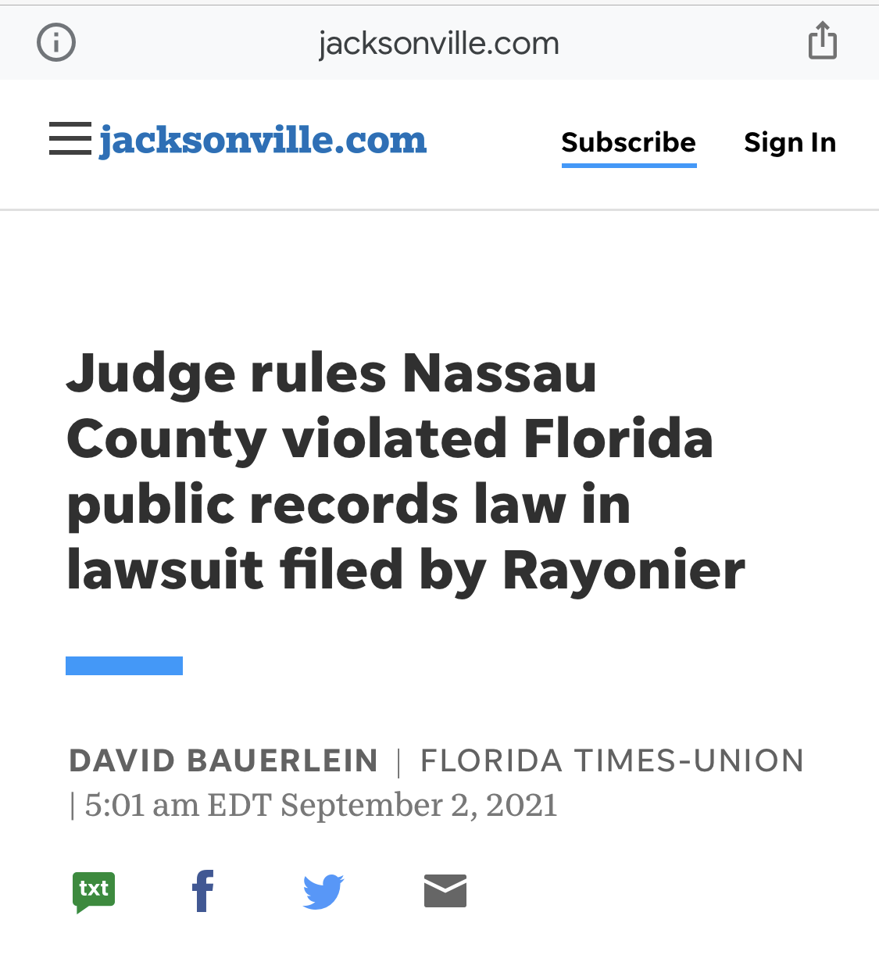
Public Records Make the News
Notes:
Judge rules Nassau County violated Florida public records law in lawsuit filed by Rayonier | firstcoastnews.com

Slide 53
Misuse of Position Makes the News
Notes:
Husband of Sunny Isles Commissioner cited wife's position after alleged hit-and-run accident (floridapolitics.com)

Slide 54
Ethics Assistance
Office of Ethics, Compliance & Oversight
Kirby Oberdorfer, Ethics Director
Andrea Myers, Program and Training Manager
255-5510
630-1015 (Help Line)

Slide 55
Thank you!

